Slide 1

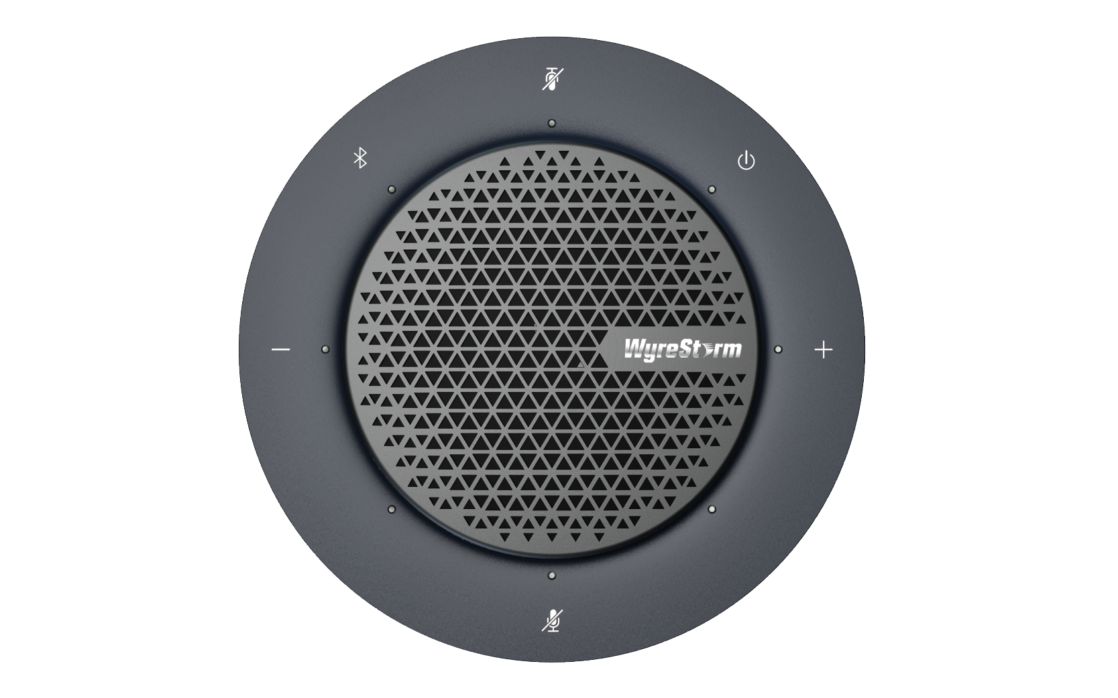

HALO 80
Product Guide
Plug and Play Portable USB and Bluetooth Conference Speakerphone
Award-Winning Audio-Visual Solutions Manufacturer

Slide 2

Contents
Product Overview & Key Features
Why Choose Us?
Interface & Specifications
Typical Connection & Applications
Competitor Analysis
Quick Installation Guide & Web UI Introduction
Q & A Session
Powerful · Reliable · Simple

Slide 3
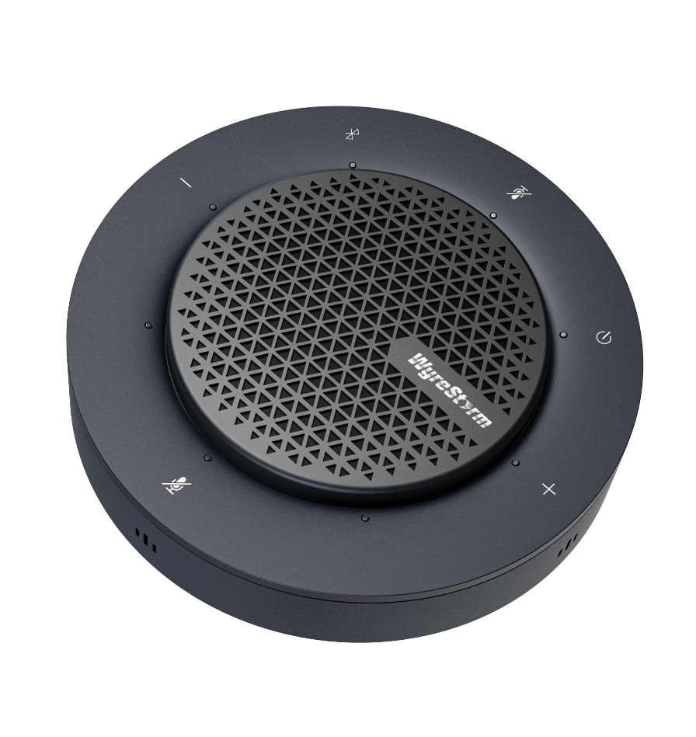
Product Overview
Plug and Play Portable USB and Bluetooth Conference Speakerphone
The HALO 80 is designed for modern flexibility and performance. This all-in-one speakerphone features advanced AEC (Acoustic Echo Cancellation), AGC (Auto Gain Control), and ANS (Automatic Noise Suppression), delivering crystal-clear audio in remote conferences. With support for both USB and Bluetooth connectivity, it adapts seamlessly to various setups—from huddle rooms to large meeting spaces. Equipped with four omnidirectional mic arrays and a powerful full-range speaker, it offers plug-and-play convenience and broad compatibility with major operating systems and conferencing platforms.
By cascading up to nine HALO 80 units, it ensures reliable coverage and exceptional audio quality, making it an ideal solution for meeting spaces of any size.
Powerful · Reliable · Simple

Slide 4






Main Features
Premium Mic & Speaker Array
Four precision omnidirectional microphones pick up voices in all directions, paired with a high-fidelity 3W full-range speaker that delivers rich, natural sound throughout the room.
Versatile Connection
Connect instantly via USB or Bluetooth, empowering participants to join meetings their way.
Premium Audio Performance Advanced audio processing with Acoustic Echo Cancellation, Noise Suppression, and Automatic Gain Control delivers crystal-clear speech while eliminating distractions to ensure every word is heard.
Instant Meeting Start‑Up
Truly plug-and-play: easy to install, no complex setup. Just connect, collaborate, and communicate.
Room‑Ready Scalability
Cascade up to nine units for effortless coverage, from compact huddle rooms to expansive boardrooms, without sacrificing clarity.
Universal Platform Support
Fully compatible with Windows, macOS, and all major unified communications platforms for seamless integration into your workflow.
Powerful · Reliable · Simple

Slide 5
Why Choose Us: 1. Crystal-Clear Collaboration, Anywhere
Engineered for modern hybrid work environments, it delivers exceptional audio quality, seamless connectivity, and effortless scalability, whether in a huddle room, boardroom, or large meeting space.
Premium Audio Clarity
Flexible Connectivity
Four omnidirectional mic arrays and a powerful 3W speaker ensure every voice is captured with clarity and delivered with natural warmth.
Connect via USB or Bluetooth for seamless compatibility with laptops, tablets, and mobile devices.
Intelligent Audio Optimization
Scalable Meeting Coverage
Featuring Acoustic Echo Cancellation, Noise Suppression, and Automatic Gain Control, the system adapts automatically to deliver optimal sound in any environment.
Cascade up to nine units to cover large spaces without losing audio quality.
Powerful · Reliable · Simple

Slide 6
Why Choose Us: 2. Simplicity Meets Professional Performance
Designed for ease of use and uncompromising quality, our speakerphone combines advanced audio technology with seamless plug-and-play functionality, ensuring more productive meetings.
Instant Setup
Consistent Audio Quality for Any Room Size
Easy installation without complex configuration.Plug in or pair via Bluetooth and start your meeting in seconds.
Delivers consistent audio quality from small meeting rooms to large conference spaces.
Universal Compatibility
Expansion‑Ready Design
Works seamlessly with Windows, macOS, and all major unified communications platforms such as Zoom, Teams, and Webex.
Flexible architecture and connectivity options ensure your system can grow with your business needs.
Powerful · Reliable · Simple

Slide 7
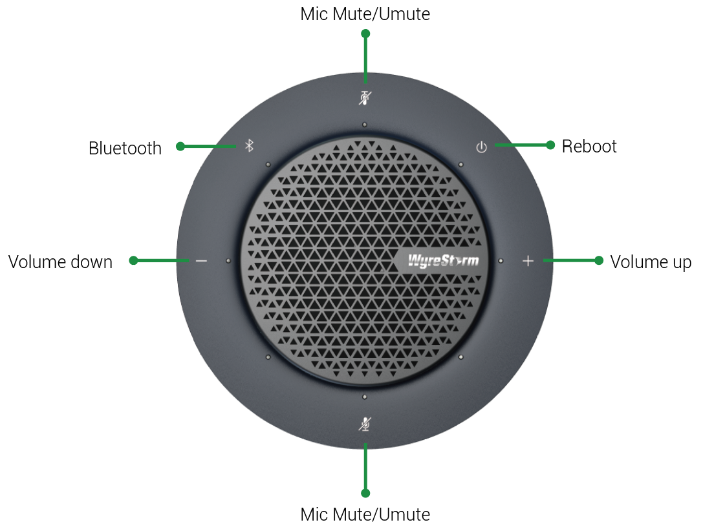
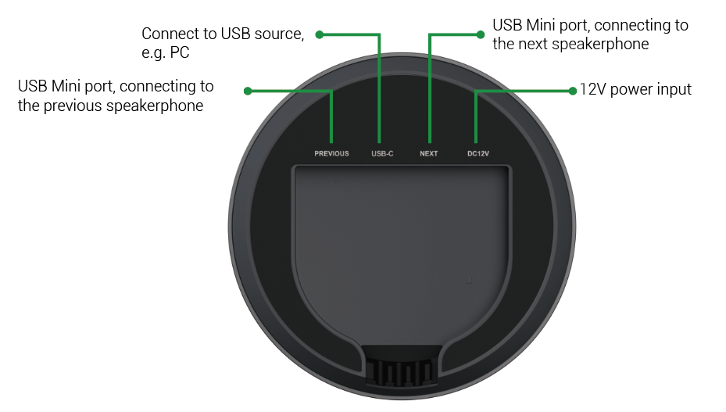
Interface of the Product
Featuring:
Front Panel
Touch Button Controls ：
Capacitive touch buttons allow easy adjustment of volume, management of Bluetooth pairing, and muting/unmuting of the microphone.
Mini-USB & USB-C Ports：
Mini‑USB port enables effortless device cascading, while USB‑C delivers plug‑and‑play connection to your laptop or other devices.
Rear Panel
Powerful · Reliable · Simple

Slide 8
Specifications & Packing List
Main Specifications
Ports | USB input | 1 x USB Type-C port. The following cables are recommended to be used to connect with source device: USB 2.0 Type-A to USB Type-C cable USB Type-C cable (USB 2.0 or above)
 | Daisy-chain port | 2 x USB Mini
Mics | Mics | Omnidirectional digital mic arrays consisting of 4 mics
 | Pick-up range | Up to 5m
Speaker | Speaker output power | 3W
Others | AEC,AGC,ANS | Yes
 | Bluetooth | Bluetooth 5.0
 | USB protocol | UAC
 | Power Supply | 12V
 | Compatible OS | Windows 10/11, Mac OS 10.10 or above
What’s in the Box?
1 x HALO 80 Speakerphone
1 x USB 2.0 Type-A to Type-C Cable (L=1.5m)
1 x DC 12V Power Adapter
1 x USB Mini Cable (L=3m)
1 x Quick Start Guide
Powerful · Reliable · Simple

Slide 9
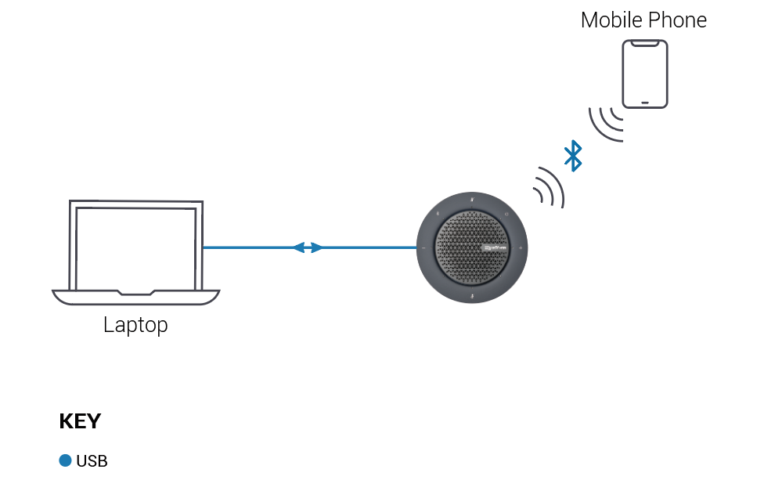
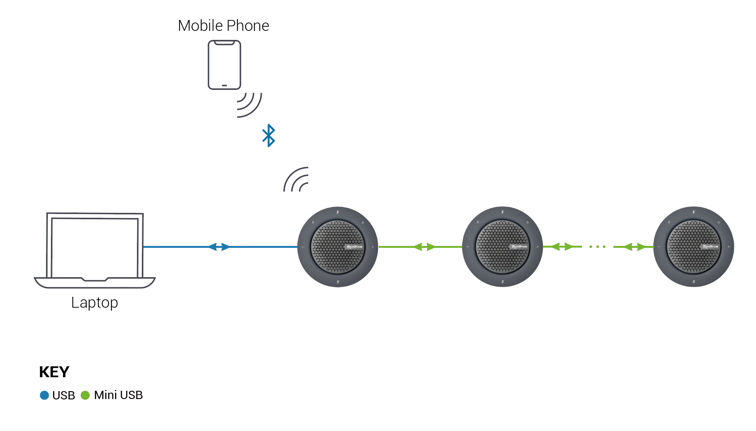
Typical Connection & Applications
The HALO 80 supports connection to a source device via USB or Bluetooth and offers two application modes: Standalone mode and Daisy-Chain mode. Please refer to the typical connection diagram below.
Cascading Connection Table
Cascading Units | DC Port | PREVIOUS Port | NEXT Port | USB-C
1st HALO 80 | ✓ (With power adapter) |  | ✓ | ✓
2nd HALO 80 |  | ✓ | ✓
3rd HALO 80 |  | ✓ | ✓
4th HALO 80 | ✓ (With power adapter) | ✓ | ✓
5th HALO 80 |  | ✓ | ✓
6th HALO 80 |  | ✓ | ✓
7th HALO 80 | ✓ (With power adapter) | ✓ | ✓
8th HALO 80 |  | ✓ | ✓
9th HALO 80 |  | ✓
Standalone Mode
*When Daisy-Chain mode, every three HALO 80 units require a single power adapter connection to the first unit and only the type-c port on the first HALO 80 of the whole wiring connection is working.
*Daisy-Chain Mode

Slide 10
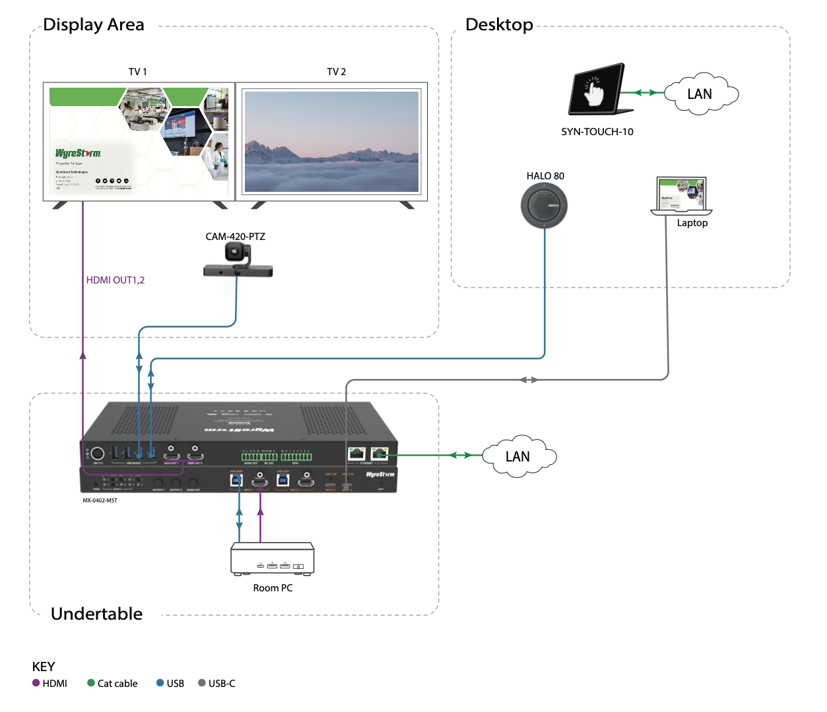
Typical Connection & Applications
Application Scenario 1: Medium Meeting Room
This solution empowers participants to effortlessly join the meeting. Its user-friendly design ensures smooth communication, enhancing collaboration and productivity for all participants.
Key Benefits Include:
Dual-Screen Connection: Supports dual-screen setup for clear and comprehensive presentations
Full-Featured USB-C Integration: Provides all-in-one transmission via USB-C, combining video, audio, Ethernet, USB data, and power through a single cable for simplified setup.
MST Capability: Enables extended content sharing and productivity with MST support

Slide 11
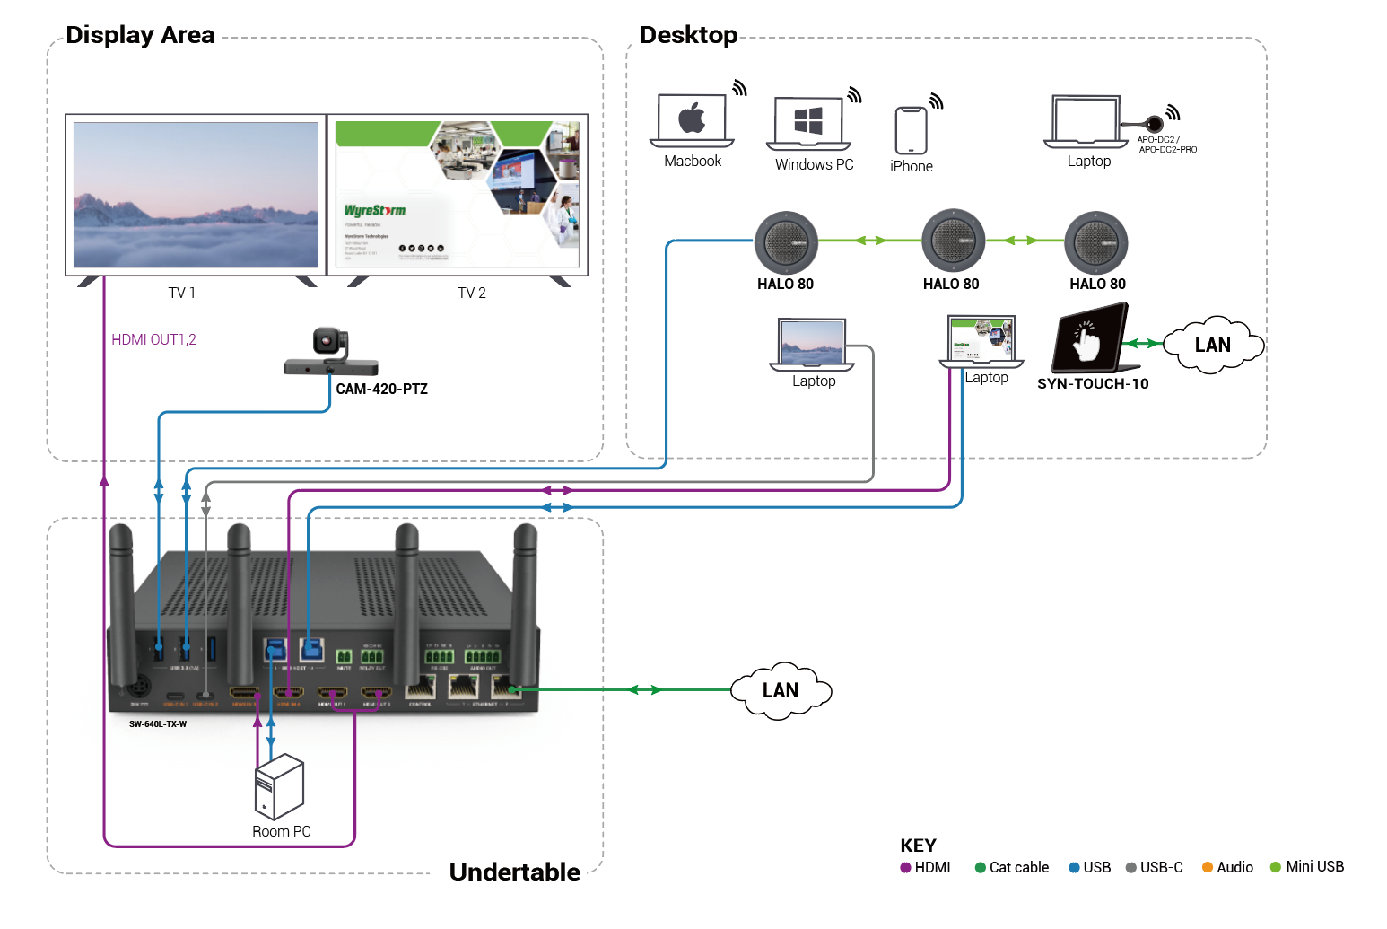
Typical Connection & Applications
Application Scenario 2: Medium Meeting Room
This solution simplifies installation with its plug-and-play design, significantly enhancing meeting efficiency for both in-person and remote conferencing, ensuring every meeting is productive and smooth.
Key Benefits Include:
Multiple Casting Methods: Simplifies presentations with various casting options.
Scalable Cascading Setup: Scales the number of HALO 80 units to fit different meeting room sizes.
Smart Panel: One-click control for all functions.
Dual-Screen Connection: Ensures clear and comprehensive display.
Fast Seamless Switching: Quick and smooth transitions between inputs.

Slide 12
Comparison with Other Competitors
 |  | WyreStorm HALO 80 | Jabra Speak 510 | Jabra SPEAK2 55 | EMEET M3 | Nearity A20S
Audio | Speaker output | Maximum 27W (Daisy chain) | Peak at 10W | NA | 5W | 5W
 | Ideal for room sizes | Huddle to large room | Huddle room | Small room | Small to medium room | Huddle to large room
 | Number of microphones | 4 | 1 | 4 | 4 | 8
 | Microphone pick up range | 5m per unit, scalable via cascading | Up to 1.5m | Up to 2.3m | Up to 5m | Up to 5m
 | AEC (Acoustic Echo Cancellation) | Yes | Yes | Yes | NA | Yes
 | AGC (Auto Gain Control) | Yes | NA | Yes | Yes | Yes
 | Noise suppression | Yes | NA | Yes | Yes | Yes
 | Full-duplex audio | Yes | No | Yes | Yes | Yes
Connectivity | Connectivity | USB, Bluetooth | USB, Bluetooth | USB C or USB A, Bluetooth (For smartphone/tablet only) | USB, Bluetooth | USB
 | Bluetooth support | Bluetooth 5.0 | Bluetooth 3.0 | Bluetooth 5.1 | Bluetooth 5.0 | No
 | Daisy chain support | Up to 9 units | No | No | Up to 2 units | Up to 6 units

Slide 13
Quick Installation Guide
Effortlessly set up your HALO 80 with simple steps, ensuring seamless configuration and an exceptional audio experience.
Connect Interfaces: Follow the standard connection guidelines and adjust connections according to your setup for optimal performance.
Set up Your Cascading: Connect the first unit to your PC via the USB-C port, then connect it to the NEXT and PREVIOUS units using a Mini USB cable. (One power adapter can support up to three HALO 80 units, and should be connected to the first unit.)
Start the Device: Use the intuitive touch control button to operate the speakerphone function.
Powerful · Reliable · Simple

Slide 14

Final Thoughts
Q & A Session
Got questions? Don't hesitate to ask away.
Powerful · Reliable · Simple

